Slide 1

Breast Cancer Detection using Machine Learning
Mentored By - Prof. Suvobrata Sarkar
Group No - 45
Avishek Kumar Bose(12000120014)
Raneet Roy(12000120018)
Abhinav Kumar (12000120015)

Slide 2
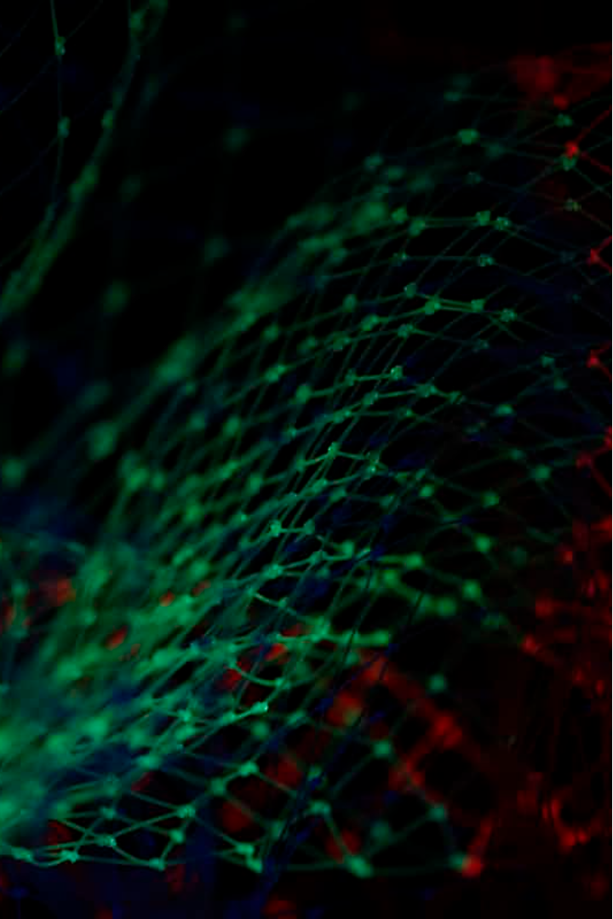
Introduction
Promising Results: Machine learning (ML) in breast cancer detection has demonstrated significant promise in recent years.
Enhanced Accuracy: ML algorithms improve accuracy in identifying and diagnosing breast cancer, contributing to more reliable outcomes.
Early Risk Identification: ML algorithms can identify individuals at high risk of developing breast cancer before symptoms manifest, enabling timely interventions.
Cost-Effectiveness: ML contributes to cost-effective healthcare by reducing the need for expensive tests and procedures in breast cancer detection and treatment.

Slide 3

Literature Survey
Paper 1: Breast Cancer Detection using Machine Learning Techniques
Authors :- Sweta Bhise, Shrutika Gadeka, Aishwarya Singh Gaur, Simran Bepari, Deepmala Kale, Dr, Shailendra Aswale
Summary : The study underscores the superior accuracy and precision of Convolutional Neural Networks (CNNs) for breast cancer detection compared to other machine learning algorithms like SVM, Random Forest, KNN, Logistic Regression, and Naïve Bayes. It emphasizes early detection and aims to enhance diagnostic systems' efficiency and reliability.
Paper 2: Detection of Breast Cancer Using Various AI-ML Classifiers
Authors :- A Malarvizhi, ANagappan
Summary :The study evaluates SVM, Random Forest, and Naive Bayes for breast cancer detection using the Wisconsin dataset, finding SVM and RF more accurate. Motivated by the need for early detection, it suggests using SVM and RF to improve diagnostic accuracy.

Slide 4
Literature Survey (Cont.)
Paper 3: Effectiveness of Applying Machine Learning Techniques and Ontologies in Breast Cancer Detection
Authors :- Hakim El Massari, Noreddine Gherabi, Sajida Mhammedi, Zineb Sabouri, Hamza Ghandi, Fatima Qanouni
Summary :The study integrates decision tree methods with ontologies for breast cancer detection, showing that ontological classifiers surpass traditional decision trees in precision and interpretability. It aims to improve diagnostic accuracy and suggests using ontological models for enhanced medical data analysis.

Slide 5
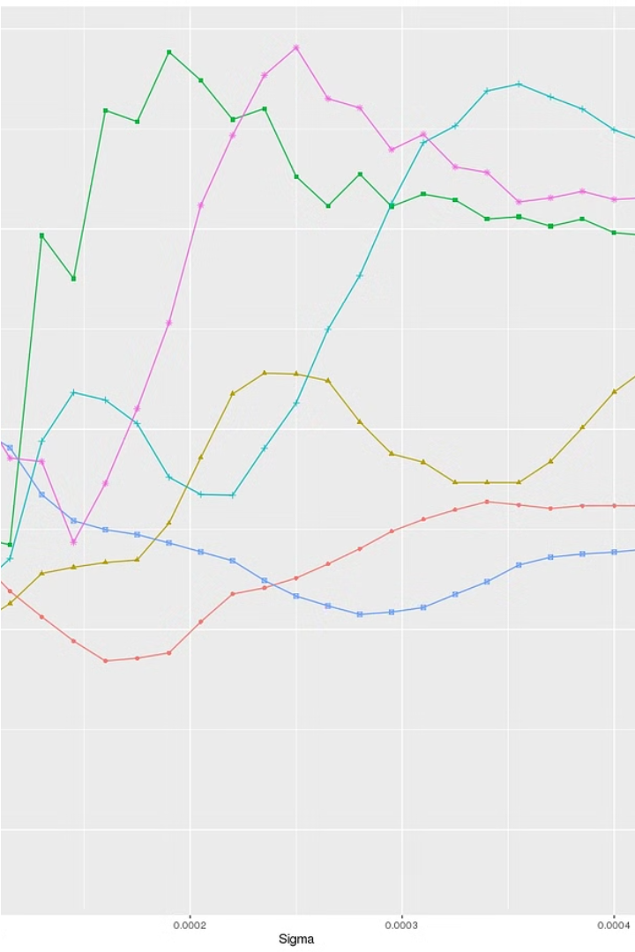
Hyperparameter Used
Grid Search - Grid search is a hyperparameter tuning technique used in machine learning to find the optimal combination of hyperparameter values for a model. Hyperparameters are parameters that are not learned from the data but are set prior to the training process.
Random Search -Random search is another hyperparameter tuning technique used in machine learning. Similar to grid search, it aims to find the optimal combination of hyperparameter values for a model, but instead of exploring all possible combinations in a predefined grid, random search samples a fixed number of hyperparameter combinations from a specified search space.
Bayes Search -Bayes search uses Bayesian probability to update the likelihood of hypotheses based on new data, optimizing search strategies. It's efficient for complex problems, incorporating prior knowledge and new evidence to find the most probable solution.

Slide 6

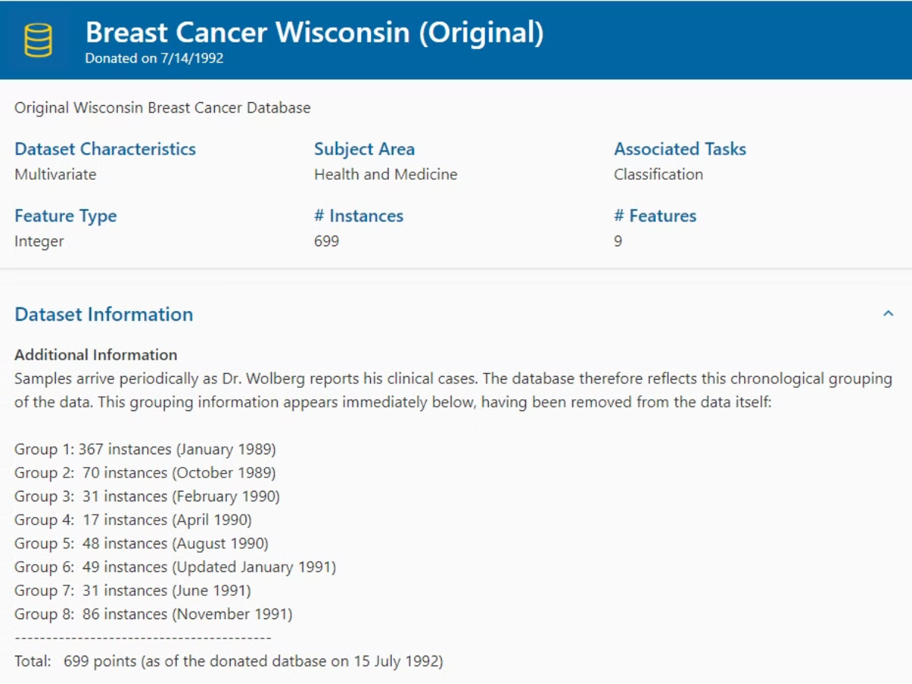
DataSet

Slide 7
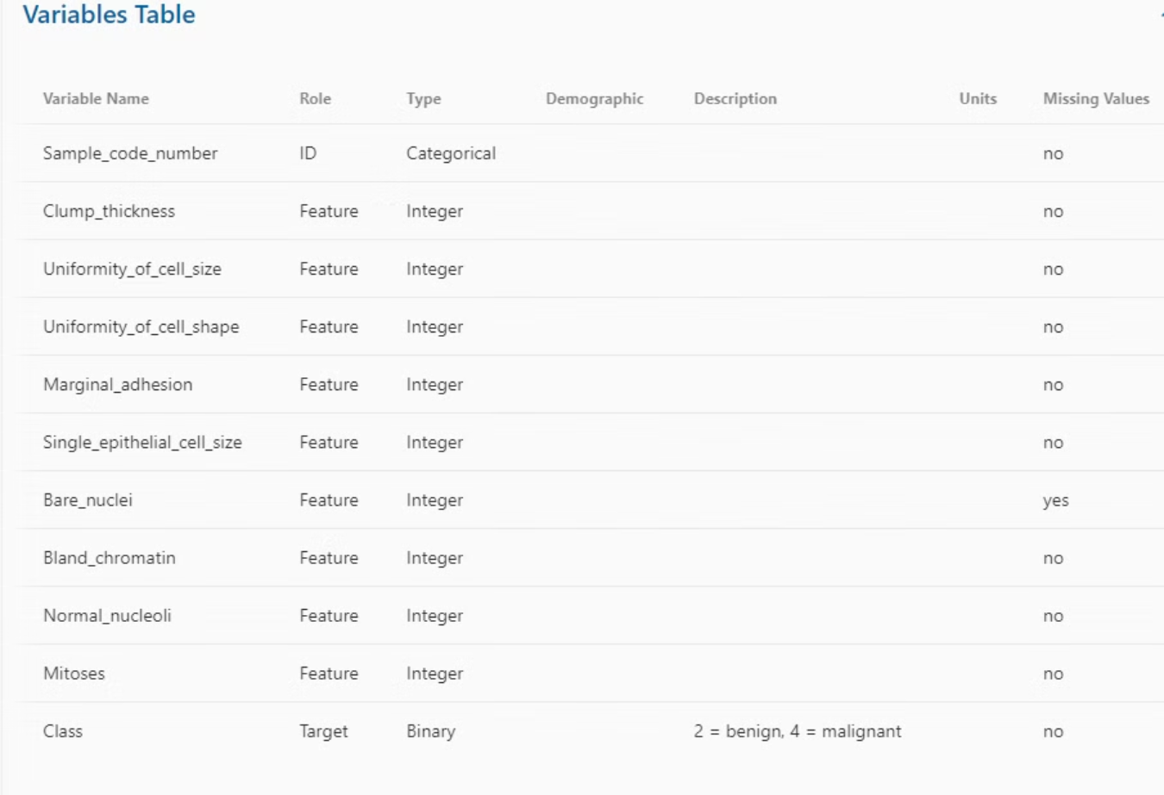

Slide 8

Methodology
Using the SVM algorithm for breast cancer detection
Import Libraries:
Import necessary libraries: pandas, sklearn.
Load Dataset:
Load the Breast Cancer dataset from (breast-cancer-winsconsin.data).
Data Preprocessing:
Split data into features and labels.
Standardize feature values.
Map the feature values in target column
Split Data:
Split the dataset into training and testing sets, 70% for training and 30% testing.
SVM Model:
Import SVM from sklearn.svm.
Define a base SVM model.

Slide 9

Methodology (Cont.)
6. Hyperparameter Tuning - Random Search:
Use RandomizedSearchCV to explore hyperparameters randomly.
7. Hyperparameter Tuning - Grid Search:
Use GridSearchCV for an exhaustive search over a specified parameter grid.
8. Hyperparameter Tuning - Bayes Search:
Use BayesSearchCV for hyperparameter tuning using a Bayesian optimization approach..
9. Evaluation:
Evaluate the model on the test set using metrics like accuracy, precision, recall, F1 score.
10. Results:
Analyzing the accuracy, precision, recall, and F1-Score of the results

Slide 10

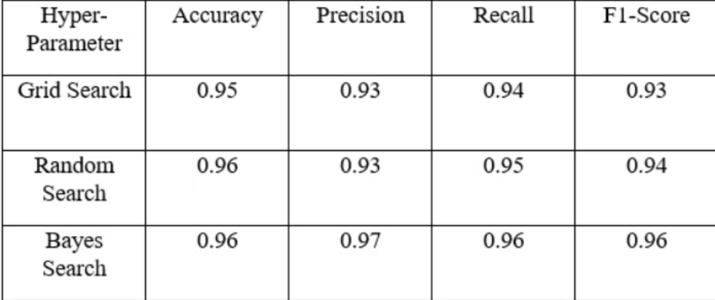
Accuracy,Precision,Recall,F1-Score for all Hyper-Parameters

Slide 11

Result Analysis
Both Random Search and Bayes Search achieve higher accuracy compared to Grid Search, with Random and Bayes Search both achieving an accuracy of 0.96.
Bayes Search significantly outperforms both Grid Search and Random Search in terms of precision, indicating fewer false positives.
Bayes Search also achieves the highest recall, suggesting it is better at identifying true positives compared to the other methods.
The F1-Score, which is the harmonic mean of precision and recall, is highest for Bayes Search, reflecting its overall balanced performance in terms of both precision and recall.

Slide 12

Conclusion
In conclusion, this project aims to enhance breast cancer detection accuracy and efficiency by leveraging machine learning algorithms. By applying Support Vector Machine (SVM) and utilizing hyperparameter tuning techniques such as Bayes Search, Random Search and Grid Search, we developed robust models capable of accurately diagnosing breast cancer using the Wisconsin Breast Cancer dataset. While significant progress has been made in exploring the effectiveness of these machine learning techniques for breast cancer detection, several avenues for future work and research remain to be explored

Slide 13

Challenges Faced
Data Preprocessing:Cleaning and preprocessing medical data, dealing with missing values, and ensuring data consistency can be challenging.
Overfitting:SVM models, especially with a large number of features, are prone to overfitting.
Imbalanced Datasets:Breast cancer datasets may be imbalanced, meaning one class (e.g., malignant or benign) has significantly fewer samples than the other.

Slide 14

Future Scope
Enhanced Data Collection: Increasing the size and diversity of datasets by including more varied demographics, imaging modalities, and clinical scenarios to improve the generalizability and robustness of machine learning models.
Multimodal Data Integration: Combining different types of data such as imaging (mammograms, MRIs), genomic, proteomic, and clinical data to create more comprehensive models that can better understand the complexities of breast cancer.
Advanced Algorithms: Developing and refining sophisticated machine learning algorithms, including deep learning networks, ensemble methods, and transfer learning, to improve detection accuracy and handle complex patterns in the data
Automated Diagnosis Systems: Creating fully automated systems that can perform routine screenings and diagnostics with minimal human intervention, potentially increasing screening rates and early detection, particularly in underserved areas.

Slide 15
Thank You

